Slide 1
Designing an
Experiment (part 2)
14
Probability
and
Statistics
COMS10011
Dr. Anne Roudaut
csxar@bristol.ac.uk

Slide 2
1
5
research question / hypothesis?
look at raw data
2
6
in(dependant) variables?
look at distributions
3a
within or between subjects?
7a
we will see why
check for normality
3b
counterbalancing?
7b
run some stats
so far we know t-test
4
8
how many repetitions/trials?
conclude

Slide 3
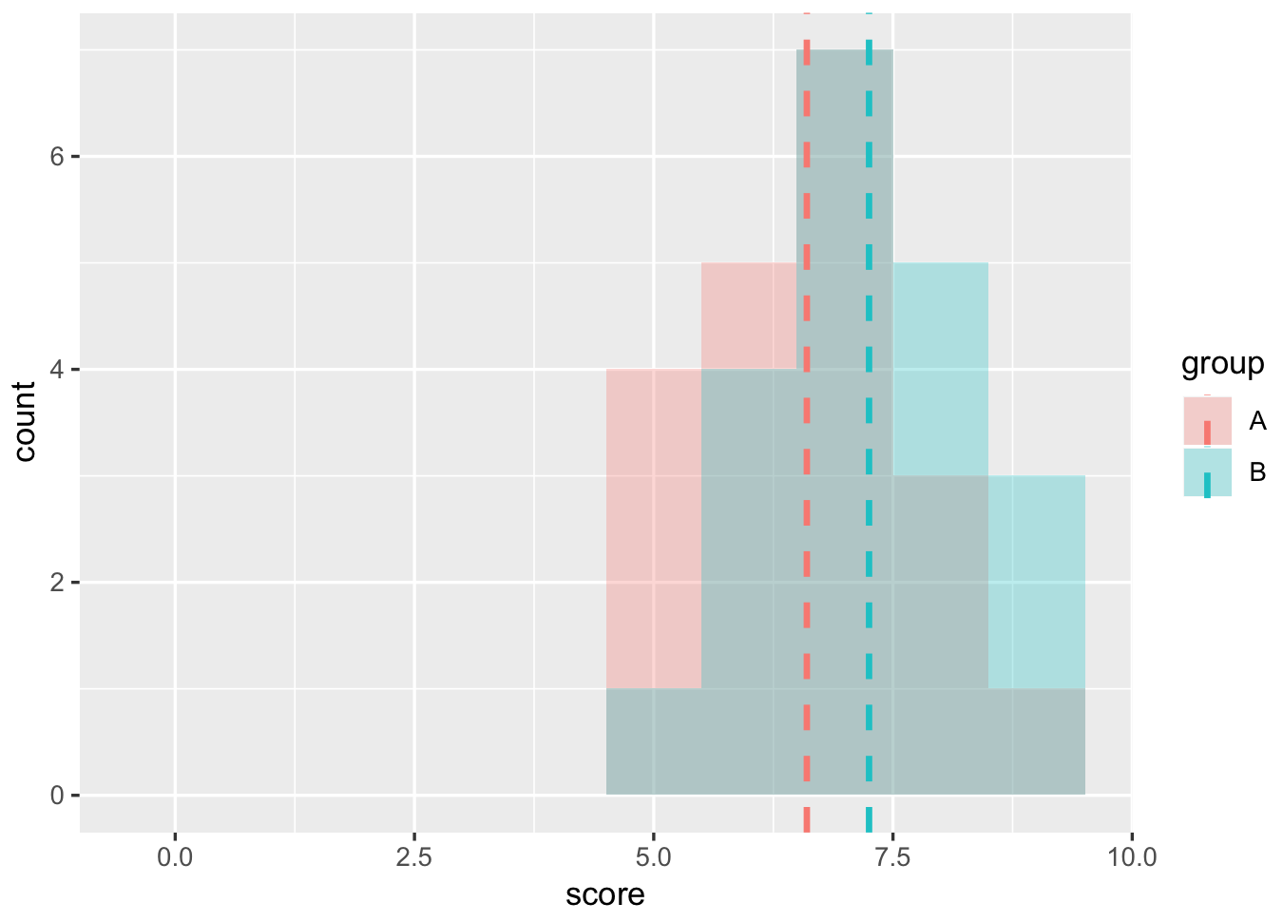
P>0.05. We did not find evidences of statistically differences between the two groups chocolate vs. no chocolate

Slide 4
let’s complexify a little

Slide 5
in our xp, let’s add a 3rd imaginary group
they get a slap if they had the smallest memorisation score
(obviously not ethical so let’s keep this hypothetical!)

Slide 6
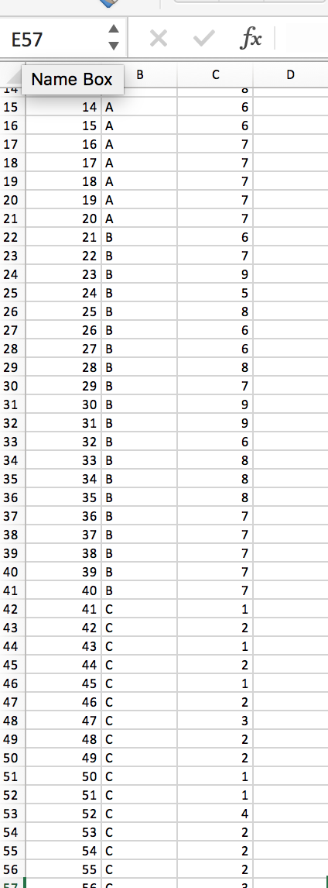
Group C: “slap”
I made up some data

Slide 7
R
# Find the mean of each group
library(plyr)
dat = read.csv("HCIXP-anova.csv", header = TRUE)
cdat <- ddply(dat, "group", summarise, score.mean=mean(score))
cdat
group score.mean
1 A 6.687500
2 B 6.877193
3 C 1.950000
# Overlaid histograms with means
library(ggplot2)
ggplot(dat, aes(x=score, fill=group)) + geom_histogram(binwidth=1, alpha=.3, position="identity") + geom_vline(data=cdat, aes(xintercept=score.mean, colour=group), linetype="dashed", size=1) + expand_limits(x = 0, y = 0)
Notes:
head(cars) # cars is a table that already comes with R and contain 50 observations of speed and distance in two rows
scatter.smooth(x=cars$speed, y=cars$dist, main="Dist ~ Speed") # scatterplot
linearMod <- lm(dist ~ speed, data=cars) # build linear regression model on full data
summary(linearMod) # summary(linearMod)$r.squared
abline(linearMod, col="blue")

Slide 8
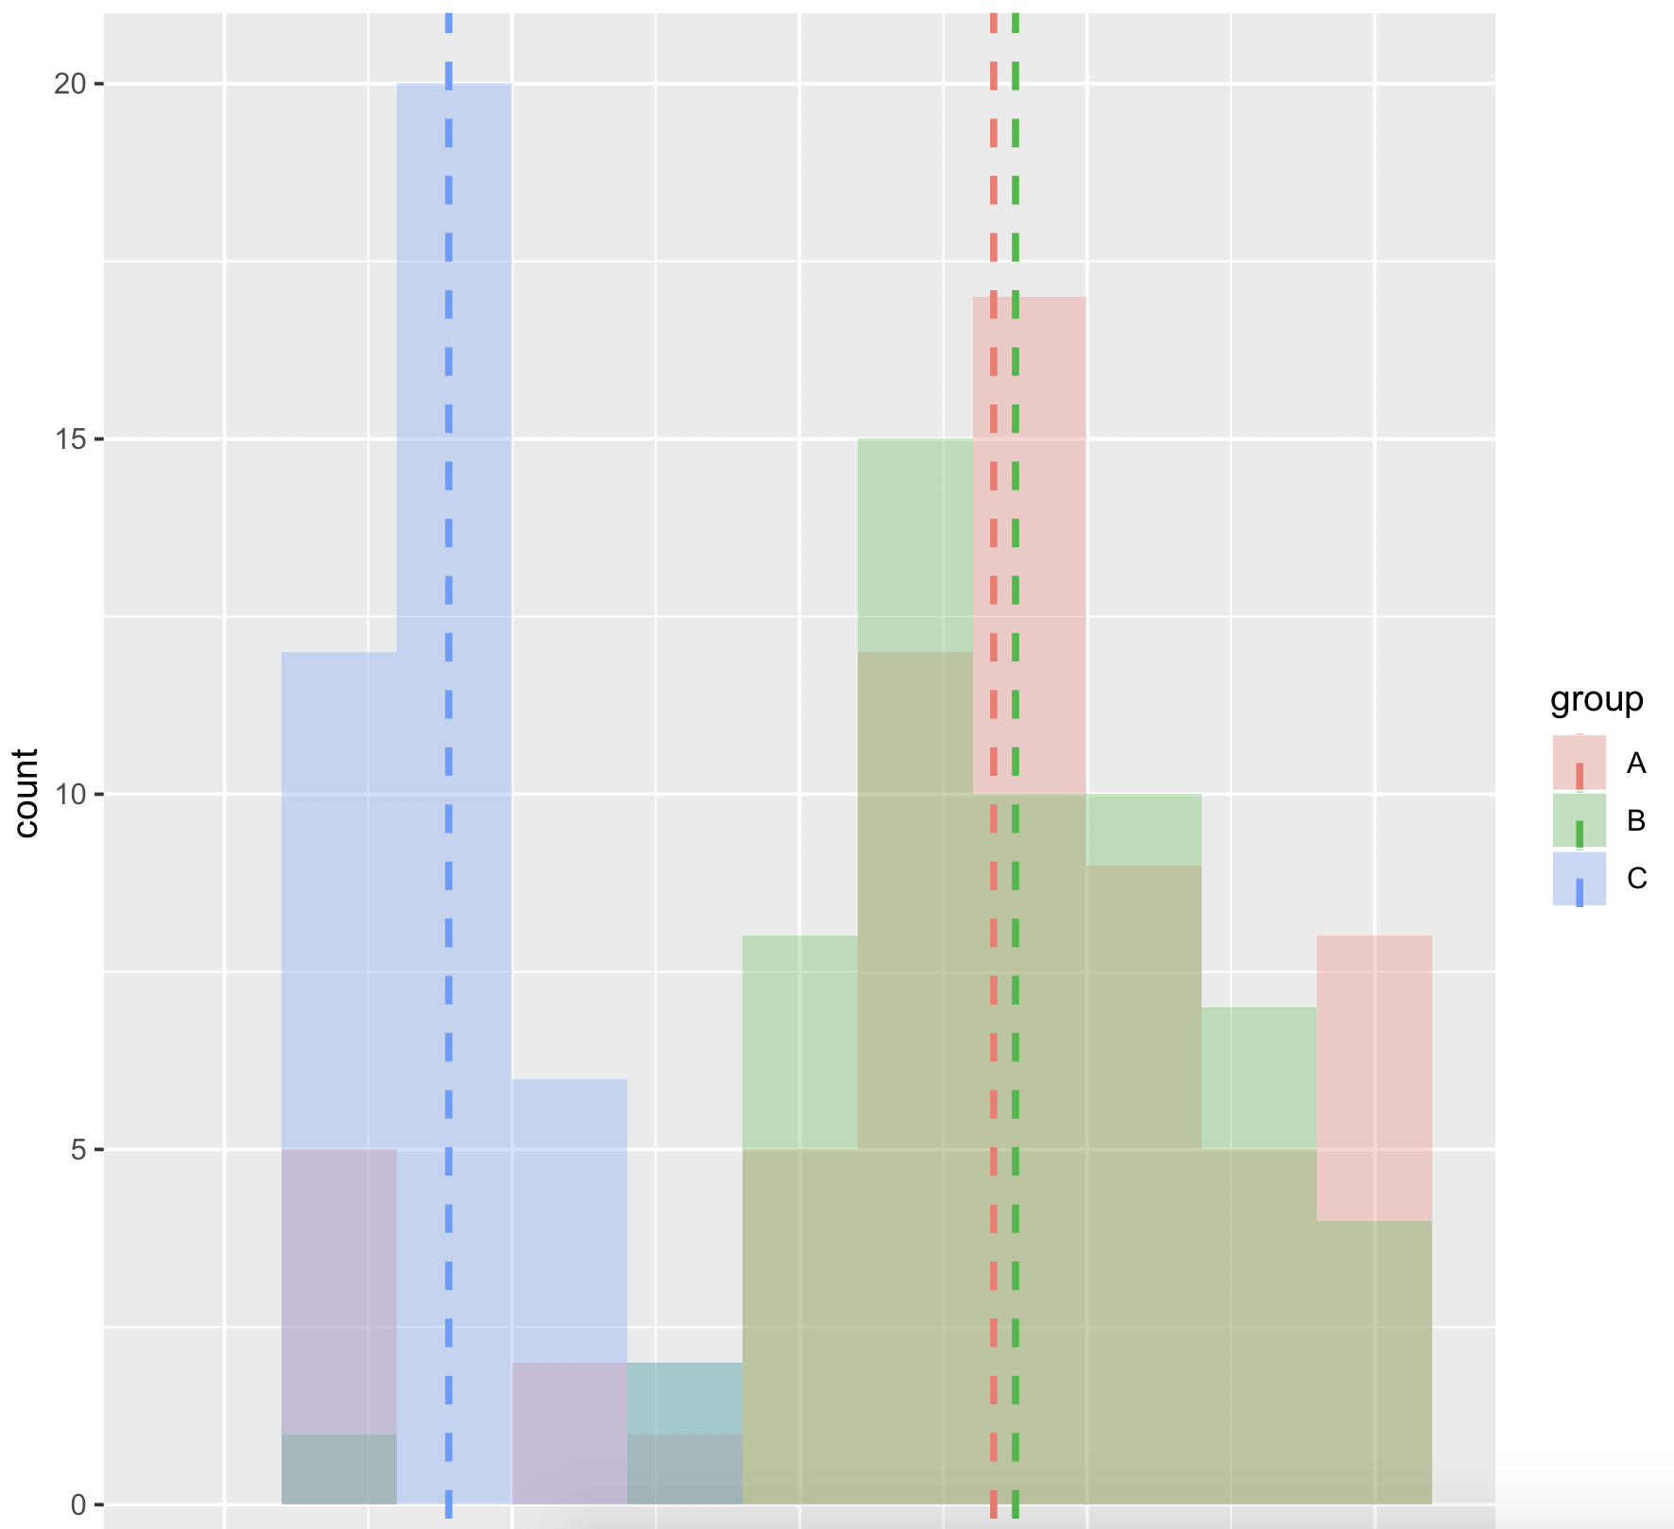
your gut feeling: are these groups different?
are these distributions likely to have happen by chance?

Slide 9
can we use t-tests?
(3 tests to compare group 1 with 2, 2 with 3 and 1 with 3)
-> yes but use Bonferoni correction
significance level not 0.05 anymore but 0.05 / number of comparisons performed (here 3) so 0.016

Slide 10
R
# Use a t-test (two-tails, unpaired)
# (we already know A vs B not significative) so we need to do
t.test(dat$score[dat$group == "A"], dat$score[dat$group == "C"], alternative = "two.sided")
t = 14.772, df = 84.53, p-value < 2.2e-16
# and
t.test(dat$score[dat$group == "B"], dat$score[dat$group == "C"], alternative = "two.sided")
t = 18.471, df = 84.088, p-value < 2.2e-16
In both case p_value < 0.016 so we can conclude!
Notes:
head(cars) # cars is a table that already comes with R and contain 50 observations of speed and distance in two rows
scatter.smooth(x=cars$speed, y=cars$dist, main="Dist ~ Speed") # scatterplot
linearMod <- lm(dist ~ speed, data=cars) # build linear regression model on full data
summary(linearMod) # summary(linearMod)$r.squared
abline(linearMod, col="blue")

Slide 11
Another test we can use when we have more than two groups to compare is an ANOVA
we have 3 different conditions (or 1 factor with 3 different levels) so we will do a one-way ANOVA

Slide 12
anova::
analyze of variance to compare multiple variables
one-way anova = one variable with multiple levels
two-way anova = two variables with multiple levels

Slide 13
R
# first we run the one-way anova
library(ez) #install.packages("ez")
ezANOVA(dat,id,between=group,dv=score)
Effect DFn DFd F p p<.05 ges
1 group 2 158 101.1658 5.181152e-29 * 0.561515
# second, run the pairwise comparison
pairwise.t.test(dat$score,dat$group, paired=FALSE, p.adjust.method="bonferroni")
A B
B 1 -
C <2e-16 <2e-16
ok something is going
to be interesting here
here are significant differences
and we don’t need to do the Bonferroni correction (already included)
Notes:
head(cars) # cars is a table that already comes with R and contain 50 observations of speed and distance in two rows
scatter.smooth(x=cars$speed, y=cars$dist, main="Dist ~ Speed") # scatterplot
linearMod <- lm(dist ~ speed, data=cars) # build linear regression model on full data
summary(linearMod) # summary(linearMod)$r.squared
abline(linearMod, col="blue")

Slide 14
we can write:
“A one-way ANOVA showed a significant effect on time for the variable Group ( F2,158=101.16, p < 0.05).”
and then:
“Post-hoc comparison t-tests (using Bonferoni correction) showed significant difference between the group C and the group A (p<0.05) and between group C and group B (p<0.05).”
<you could also give means values to give more info>

Slide 15
one last thing you could find useful: how to make a graph with confident interval

Slide 16
R
# first we run the one-way anova
library(Rmisc) #install.packages('Rmisc',dependencies=true)
tgc <- summarySE(dat, measurevar="score", groupvars=c("group"))
tgc
group N score sd se ci
1 A 64 6.687500 2.3494342 0.2936793 0.5868712
2 B 57 6.877193 1.7634197 0.2335706 0.4678982
3 C 40 1.950000 0.8149249 0.1288509 0.2606256
ggplot(data = tgc, aes(x = tgc$group, y = tgc$score)) + geom_bar(stat = 'identity', position = 'dodge') + geom_errorbar(aes(ymin= tgc$score - ci, ymax= tgc$score + ci), width=.2, position=position_dodge(.9))
Notes:
head(cars) # cars is a table that already comes with R and contain 50 observations of speed and distance in two rows
scatter.smooth(x=cars$speed, y=cars$dist, main="Dist ~ Speed") # scatterplot
linearMod <- lm(dist ~ speed, data=cars) # build linear regression model on full data
summary(linearMod) # summary(linearMod)$r.squared
abline(linearMod, col="blue")

Slide 17
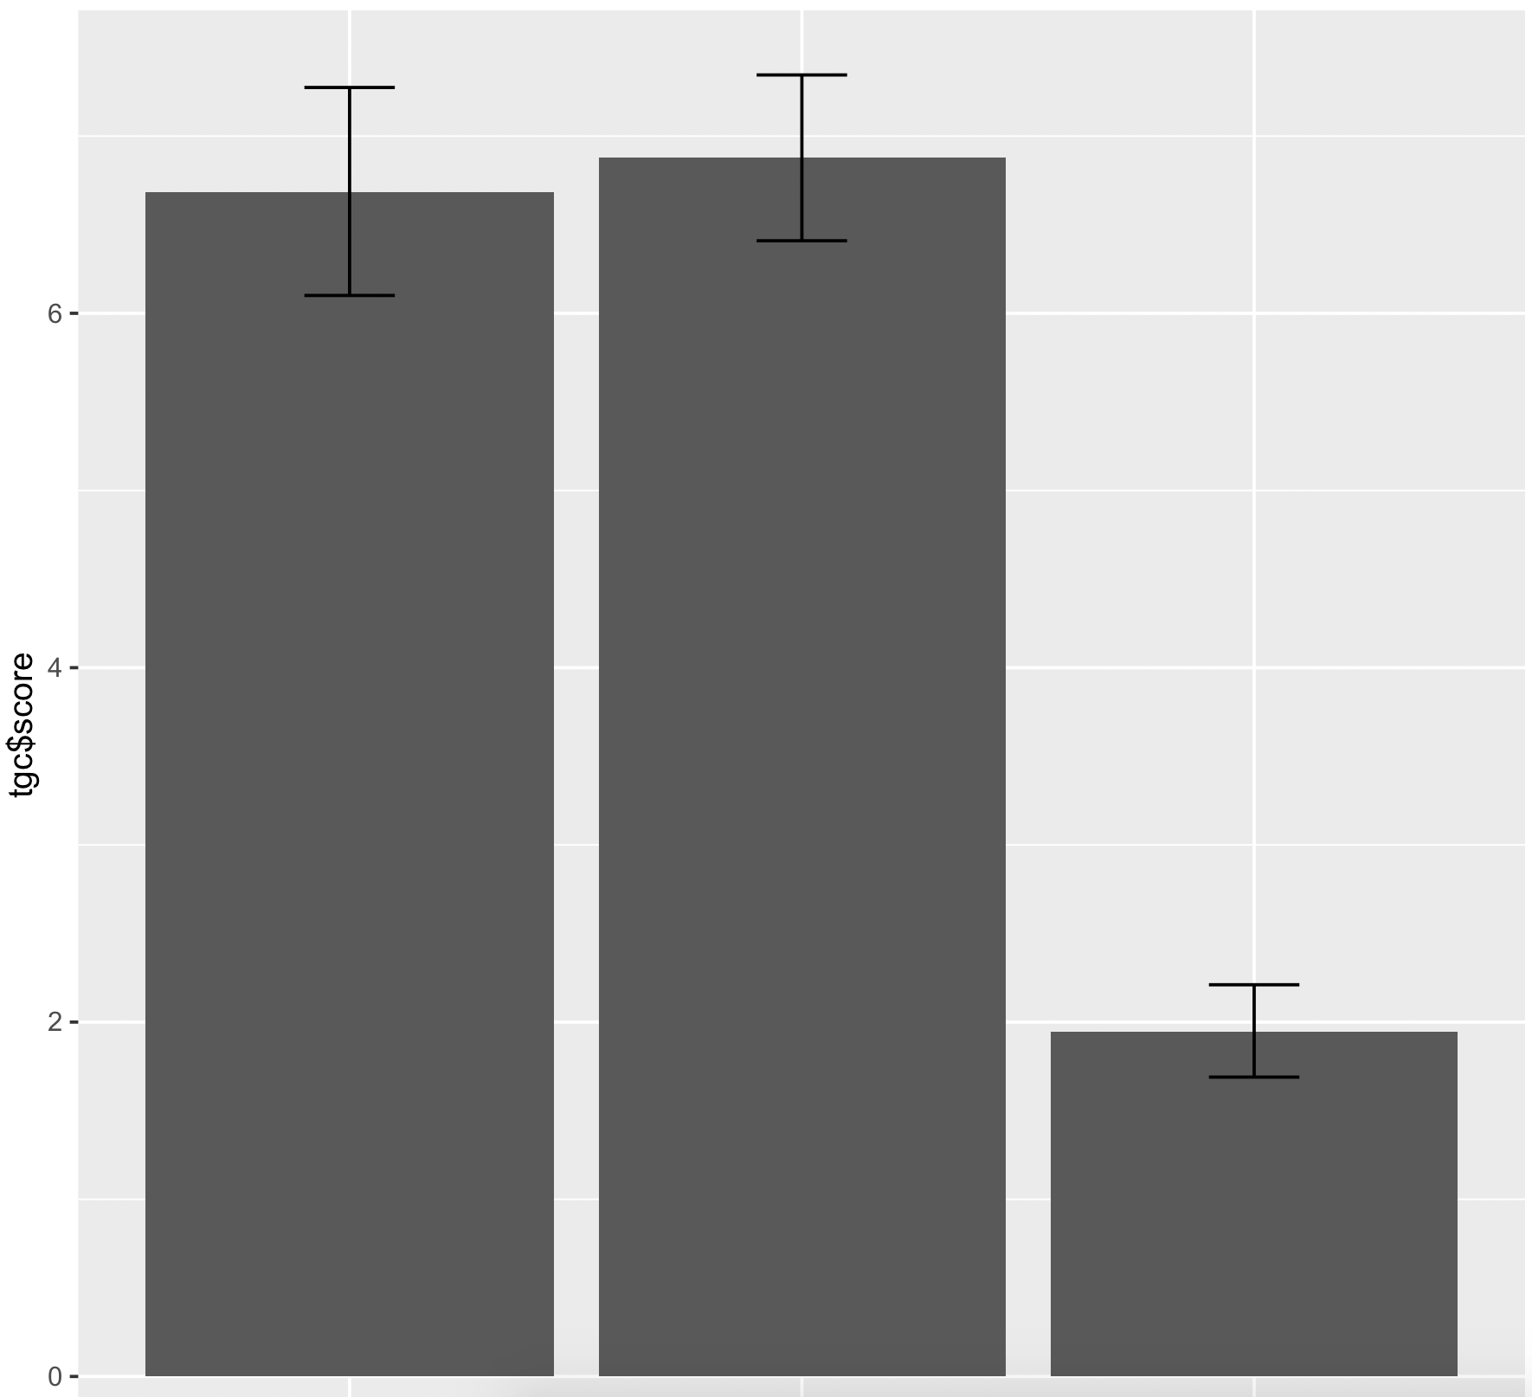

Slide 18
note of course the “slap” condition was made up
in practice it would be improbable that any ethical approval board would allow this = a mandatory process before any user studies is done!
http://www.bristol.ac.uk/red/research-governance/ethics/uni-ethics/

Slide 19
check out the Standford experiment ) to know more about why ethical considerations are crucial in user studies

Slide 20
let’s design another experiment

Slide 21
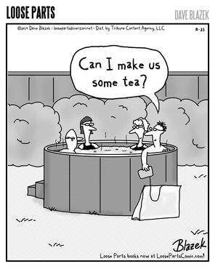
biggest cause disputes in UK
do you put milk in your cup of tea before or after the boiling water?

Slide 22
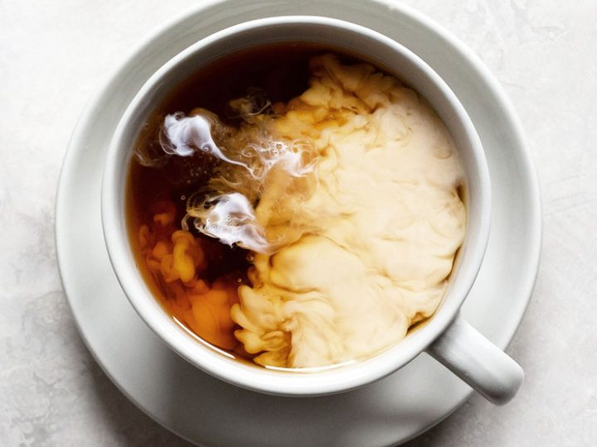
putting milk after = less tasty
(Dr Stapley of Loughborough University)

Slide 23
let’s try to reproduce the experiment by Dr Stapley
which method is the best: adding milk before or after the boiling water? (this is our research question)

Slide 24
1
What is your hypothesis?
(a sentence that can derive a test)

Slide 25
1
What is your hypothesis?
(a sentence that can derive a test)
H = participants will prefer the taste of tea when the milk is put after the boiling water

Slide 26
2
What are the dependent and independent variables?
1. What are our two conditions?

Slide 27
2
What are the dependent and independent variables?
1. What are our two conditions?
IV = One cup is made with milk before
One cup is made with milk after

Slide 28
2
What are the dependent and independent variables?
1. What are our two conditions?
2. What are you measuring and how?
IV = One cup is made with milk before
One cup is made with milk after

Slide 29
2
What are the dependent and independent variables?
1. What are our two conditions?
2. What are you measuring and how?
IV = One cup is made with milk before
One cup is made with milk after
DV = tastiness … but how?

Slide 30
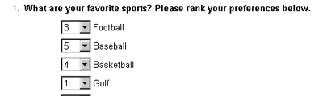
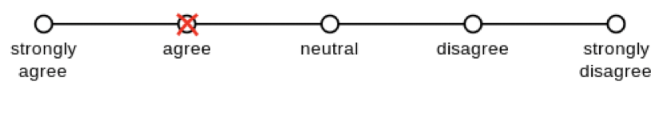
which is the best way?
[ ] ask them to rank two cup of tea
[ ] ask them to evaluate teach on a scale
X
ranking = not good, does not indicate the scale, e.g. the different might be minimal

Slide 31
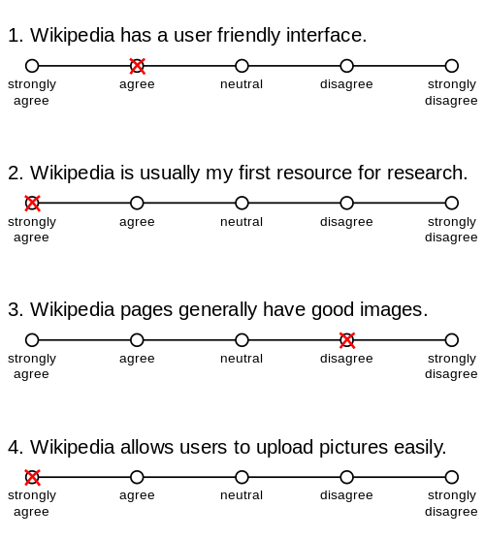
if you want to collect subjective metric such as opinions, use Likert Scale = ordinal but treated as continuous variable

Slide 32
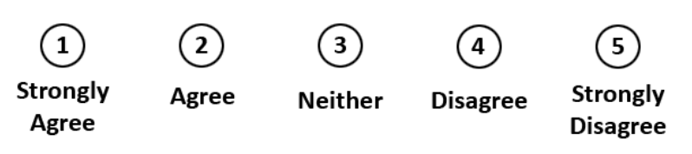
Likert scale::
psychometric response scale primarily used in questionnaires to obtain participant’s preferences or degree of agreement with a statement (generally 5pt likert scale, also 7pt)

Slide 33
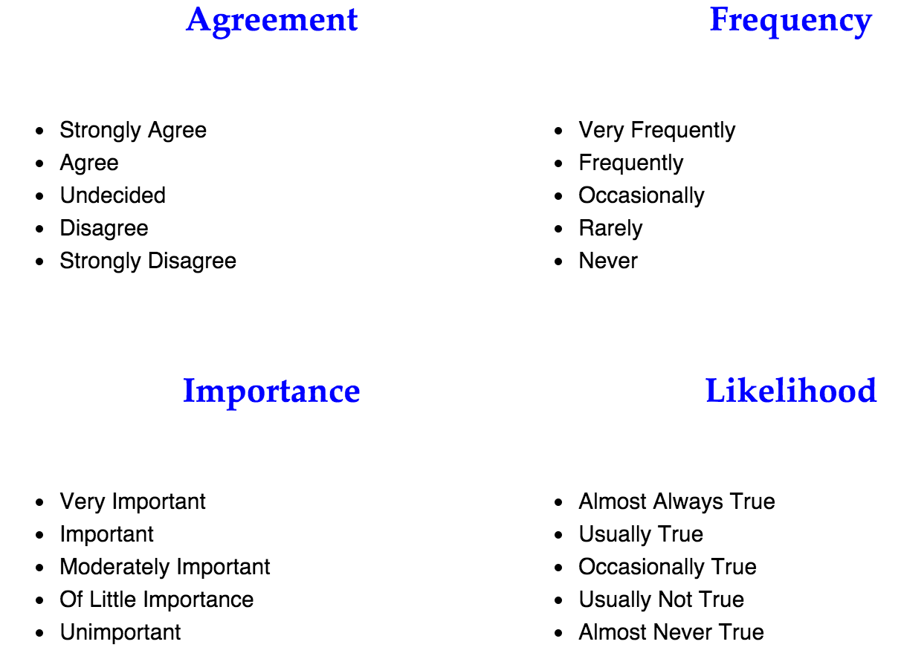

Slide 34
writing good questions

Slide 35
Goal is to collect information that is:
Valid
measures the quantity that is supposed to be measured
Reliable
measures the quantity in consistent/reproducible manner
Unbiased
measures the quantity in a way that does not systematically
under- or overestimate the true value
Discriminating
can distinguish adequately between respondents for whom
the underlying level of the quantity or concept is different

Slide 36
How many cups of coffee or tea do you drink in a day?
No, ask for an answer in only one dimension, separate the question into two
(1) How many cups of coffee do you drink during a typical day?
(2) How many cups of tea do you drink during a typical day?

Slide 37
What brand of computer do you own?
(A) IBM PC
(B) Apple
Avoid hidden assumptions
Make sure to accommodate all possible answers
Make each response a separate dichotomous item
Do you own an IBM PC? (Circle: Yes or No)
Do you own an Apple computer? (Circle: Yes or No)
Or allow for multiple responses
What brand of computer do you own? (Circle all that apply)
Do not own computer
IBM PC
Apple
Other

Slide 38
Have you had pain in the last week?
[ ] Never [ ] Seldom [ ] Often [ ] Very often
Make sure question and answer options match
Reword either question or answer to match
How often have you had pain in the last week?
[ ] Never [ ] Seldom [ ] Often [ ] Very Often

Slide 39
Where did you grow up?
Country
Farm
City
Avoid questions having non-mutually exclusive answers
Design the question with mutually exclusive options
Where did you grow up?
House in the country
Farm in the country
City

Slide 40
Which one of the following do you think increases a person’s chance of having a heart attack the most? (Check one.)
[ ] Smoking [ ] Being overweight [ ] Stress
Encourage to consider each possible response to avoid the uncertainty of whether a missing item may represent either an answer that does not apply or an overlooked item
Which of the following increases the chance of having a heart attack?
Smoking: [ ] Yes [ ] No [ ] Don’t know
Being overweight: [ ] Yes [ ] No [ ] Don’t know
Stress: [ ] Yes [ ] No [ ] Don’t know

Slide 41
On a scale from 1 to 5, how fun did you have using our new system?
1. not at all 2. Not really 3.undecided 4. somewhat 5. very much
Avoid biased questions
Design the question with mutually exclusive options
On a scale from 1 to 5, how would you rate your experience with our new system?
1. not fun at all 2. Not really fun 3.undecided 4. somewhat fun 5. very much fun

Slide 42
Rank from 1 to 3 your preference in beverage
[ ] Tea [ ] Coffee [ ] Orange Jus
Avoid ranking at all cost and rather use Likert scales
On a scale from 1 to 5 rate how much you like the following beverages
Tea: 1. not at all 2. Not really 3.undecided 4. somewhat 5. very much
Coffee: 1. not at all 2. Not really 3.undecided 4. somewhat 5. very much
Orange jus: 1. not at all 2. Not really 3.undecided 4. somewhat 5. very much

Slide 44
H = participants will prefer the taste of tea when the milk is put after the boiling water
IV = One cup is made with milk before
One cup is made with milk after
DV = tastiness
On a scale of 1 to 5 rate the tastiness of this cup?
1 very not tasty 2 not tasty 3 undecided 4 tasty 5 very tasty

Slide 45
3
Is this a within or between subjects experiment?
Do they do each condition or only one?

Slide 46
3
Is this a within or between subjects experiment?
Do they do each condition or only one?
Between: taste buds compromised by drinking a cup -> better to take two different groups
(note in this case there is nothing to counterbalance)

Slide 47
4
How many repetitions?

Slide 48
4
How many repetitions?
Only one trial (same reason, taste buds compromised)

Slide 49
H = participants will prefer the taste of tea when the milk is put after the boiling water
IV = One cup is made with milk before
One cup is made with milk after
DV = tastiness
On a scale of 1 to 5 rate the tastiness of this cup?
1 very not tasty 2 not tasty 3 undecided 4 tasty 5 very tasty
Between subjects with one trial only

Slide 50


try this with a friend during reading weeks
https://tinyurl.com/statsBristol
tea
milk
water
don’t tell them how you made the cup
tea
water
milk

Slide 51
summary

Slide 52
1
5
research question / hypothesis?
look at raw data
2
6
in(dependant) variables?
look at distributions
3a
within or between subjects?
7a
we will see why
check for normality
3b
counterbalancing?
7b
run some stats
4
8
how many repetitions/trials?
conclude

Slide 53
design the experiment in such way that the results will be easy to analyze
be sure you will be able to perform the statistical analysis

Slide 54
take away
being able top design an experiment from a research question
explain what is a Likert-style questionnaire
being able to design appropriate questions for questionnaires

Slide 55
end

